Slide 1
Restaurant Recommendation System

Slide 2
Content
Introduction of Topic
Our Approach
Data Analysis and Interpretation
Technology Used
Steps of Project
User Interface

Slide 3
Introduction of Topic
As modern consumers, we greatly benefit from Restaurant Recommendation Applications. It is so convenient to get a list of restaurants that match our preferences without much clicking, comparing, and browsing through a long list of reviews for each single business.
In this project, we want to reduce human effort of filtering a lot of things and provide them a fine User Interface with less filtering and selection options so that every customer can find a better restaurant in couple of seconds.

Slide 4
Our Approach
We have developed a recommendation engine which uses GeoSpatial feature provided by Mongo DB.
We take user Address, Budget and Distance they want restaurant in and suggest them top rated restaurants near to them.

Slide 5
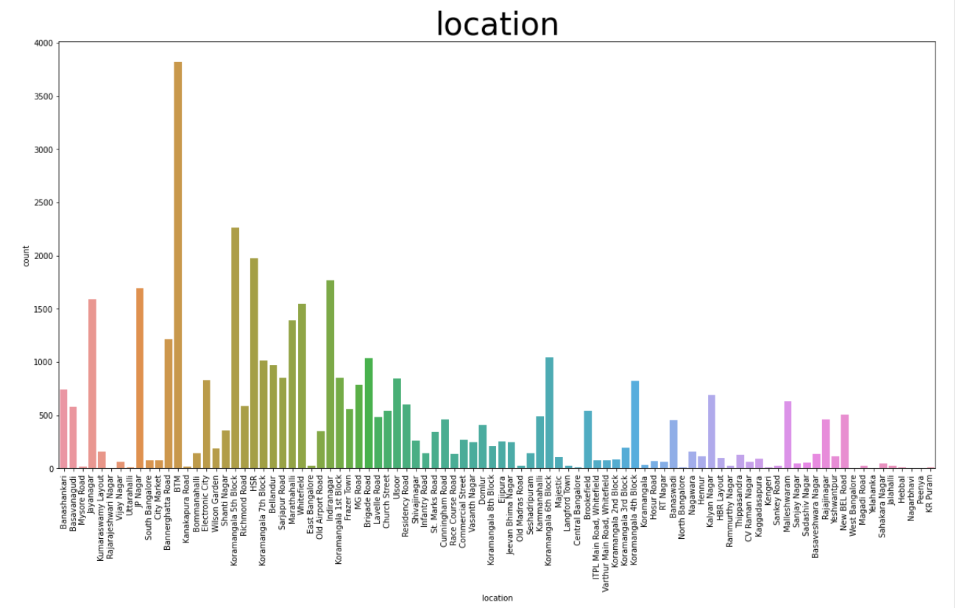
Data Analysis and Interpretation

Slide 6
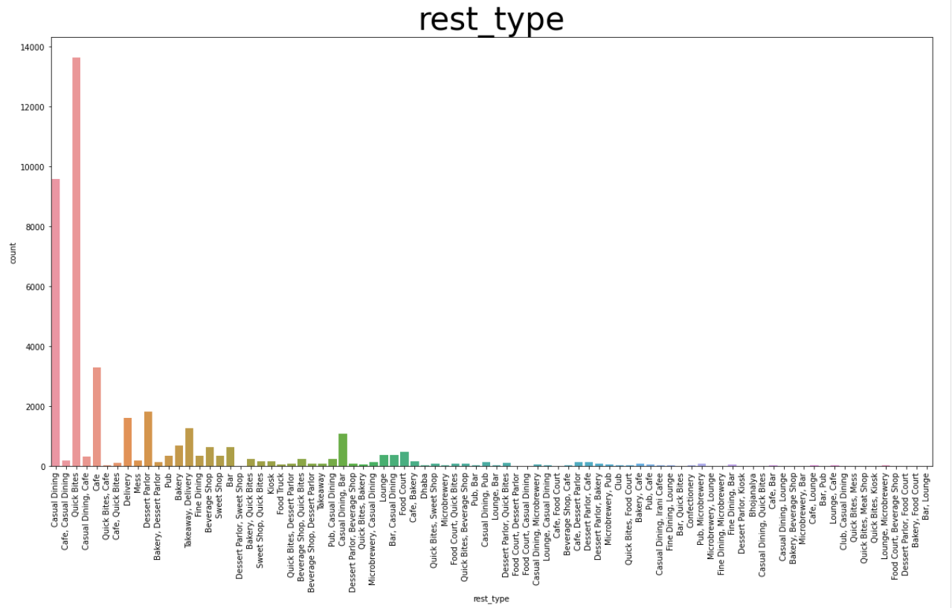
Data Analysis and Interpretation

Slide 7
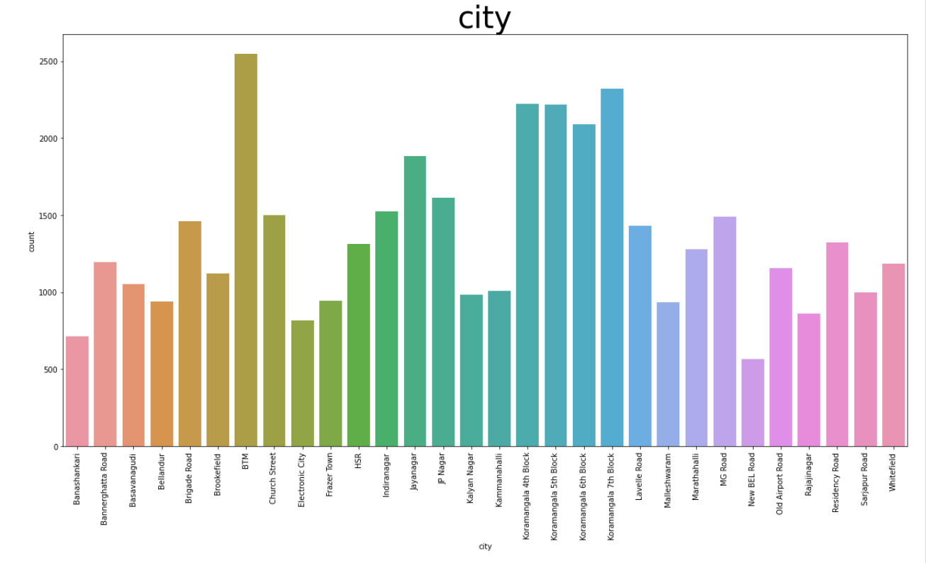
Data Analysis and Interpretation

Slide 8
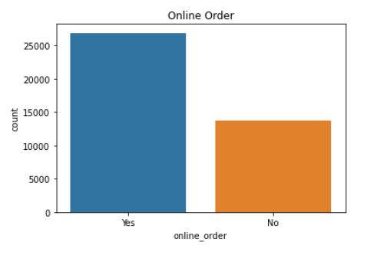
Data Analysis and Interpretation

Slide 9
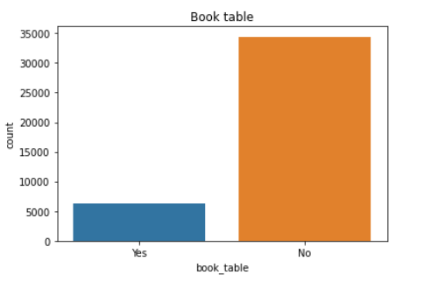
Data Analysis and Interpretation

Slide 10
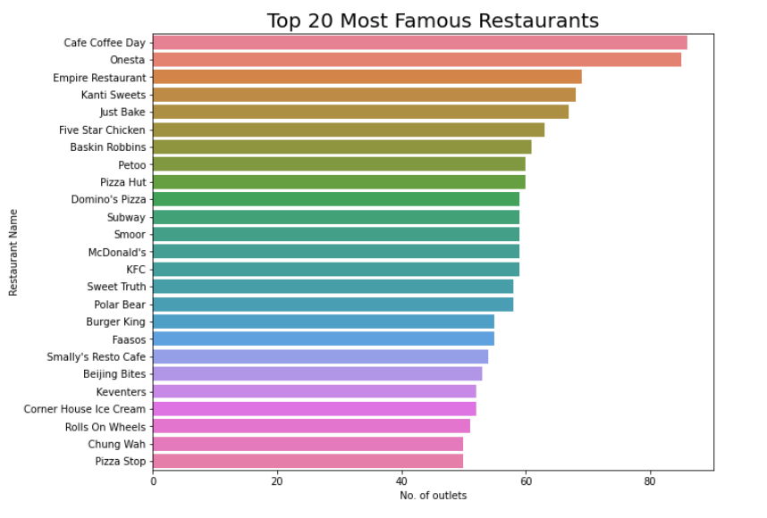
Data Analysis and Interpretation

Slide 11
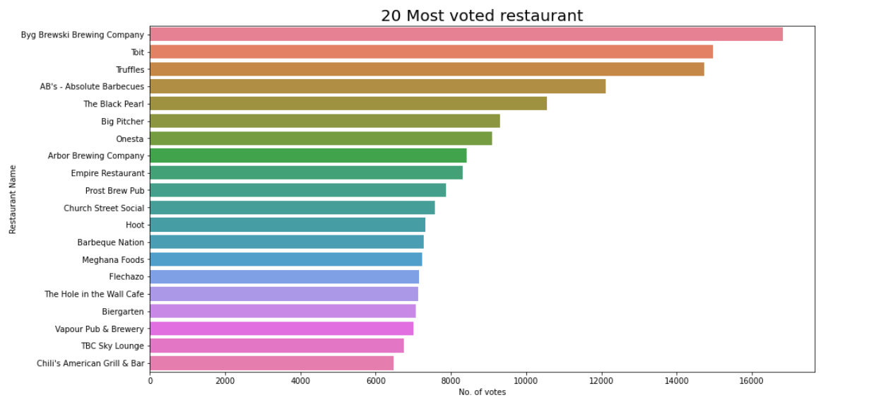
Data Analysis and Interpretation

Slide 12
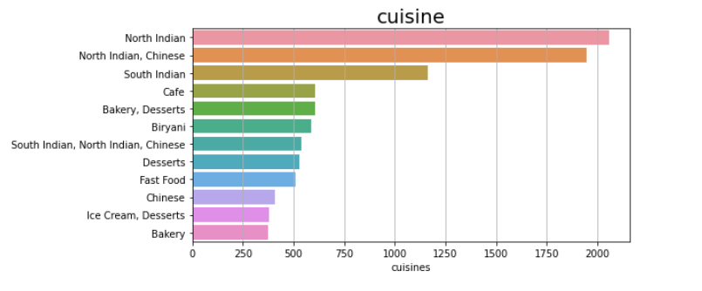
Data Analysis and Interpretation

Slide 13
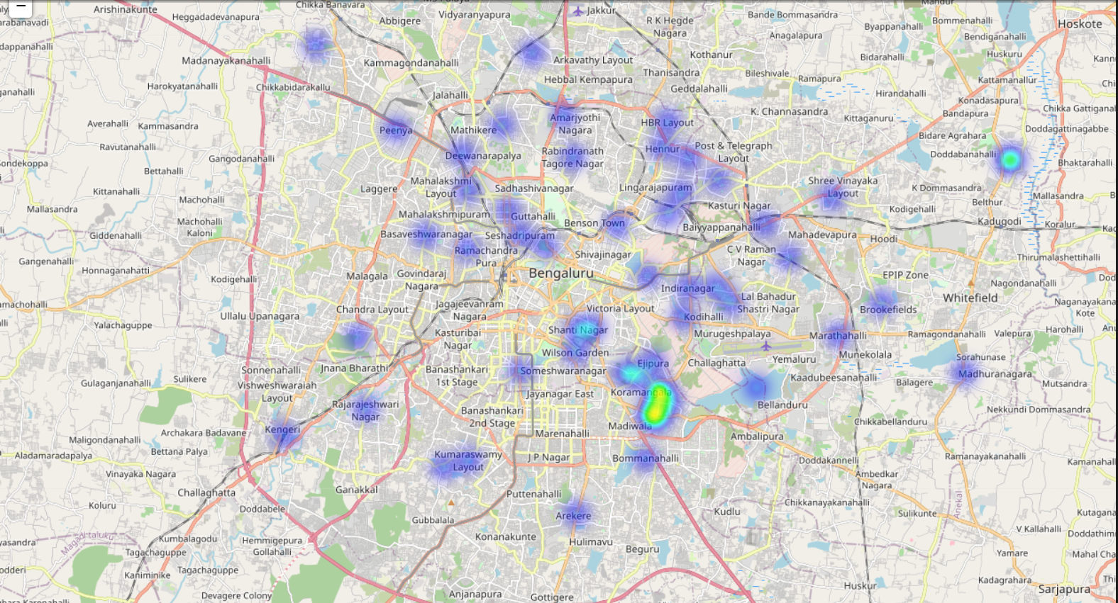
Data Analysis and Interpretation

Slide 14
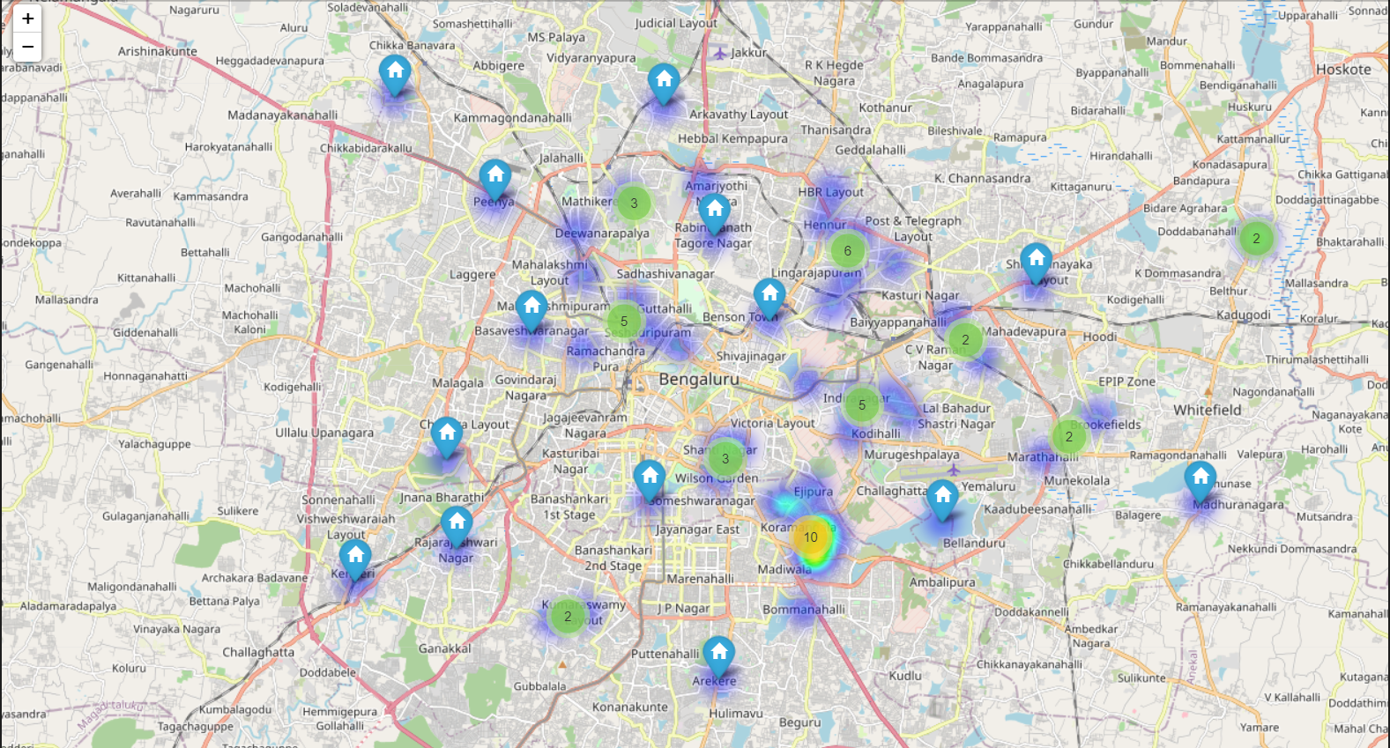
Data Analysis and Interpretation

Slide 15
Technology Used
Python
Numpy
Pandas
Flask
Spark
NLTK
Text Blob
Mongo DB

Slide 16
Steps of Project
# Data Preprocessing
* Removed unwanted and redundant features from the dataset.
* Removed null values as the percentage of those null values were very small.
* Removed duplicate values.
* Did Feature Engineering with all the remaining features to obtain data in required format.
# Exploratory Data Analysis
* With all the available data, some exploratory data analysis was done.
* Using different combinations of features for bar graph.
* As well as using geographical heatmaps to understand the locations of the restaurants.

Slide 17
Steps of Project
# NLP - Sentiment Analysis
* As the restaurants had multiple reviews, we had to get sentiments for those reviews.
* For processing and sentiment analysis of those reviews we used NLTK library and TextBlob library.
* Using scores for all those reviews, we calculated the average score for each restaurant.
# Score
* Now, we had overall rating for the restaurant, number of votes and sentiment score.
* We had to consider all these scores as to get the better result.
* We computed the final score by multiplying all these three features, which will be used for recommendations.

Slide 18
Steps of Project
# Limitations
* After all these steps, we understood there is one limitation of this model.
* The person in the middle of two clusters wil be shown restaurants from only one cluster which will it belong.
* It is not useful as the nearer better restaurant may be present in the other cluster.
# Overcoming Problem
* After analysing the above problem, I started studying different patterns of clusters, but couldn't find any better option.
* After a certain research I understood that, MongoDB geospatial indexing can be used in it.
* Using geospatial indexing, we could get the restaurants present in the certain radius from the given coordinates.

Slide 19
Steps of Project
# MongoDB implementation
* Using PyMongo library, we loaded thedata into the MongoDB database collection.
* Then created array of coordinates as per reaquirement.
* Created geospatial indexes in the coordianates feature.
* Implemented the logic for getting top ten restaurants from mongodb in pymongo.
# Deployment
* The whole project is deployed on the AWS cloud.
* We used ec2 instance for deployment.
* Firstly we created the environment for the project on the instance by installing required packages.
* Installed MongoDB 4.4.9 using it's debian package.
* And the whole project was deployed.

Slide 20
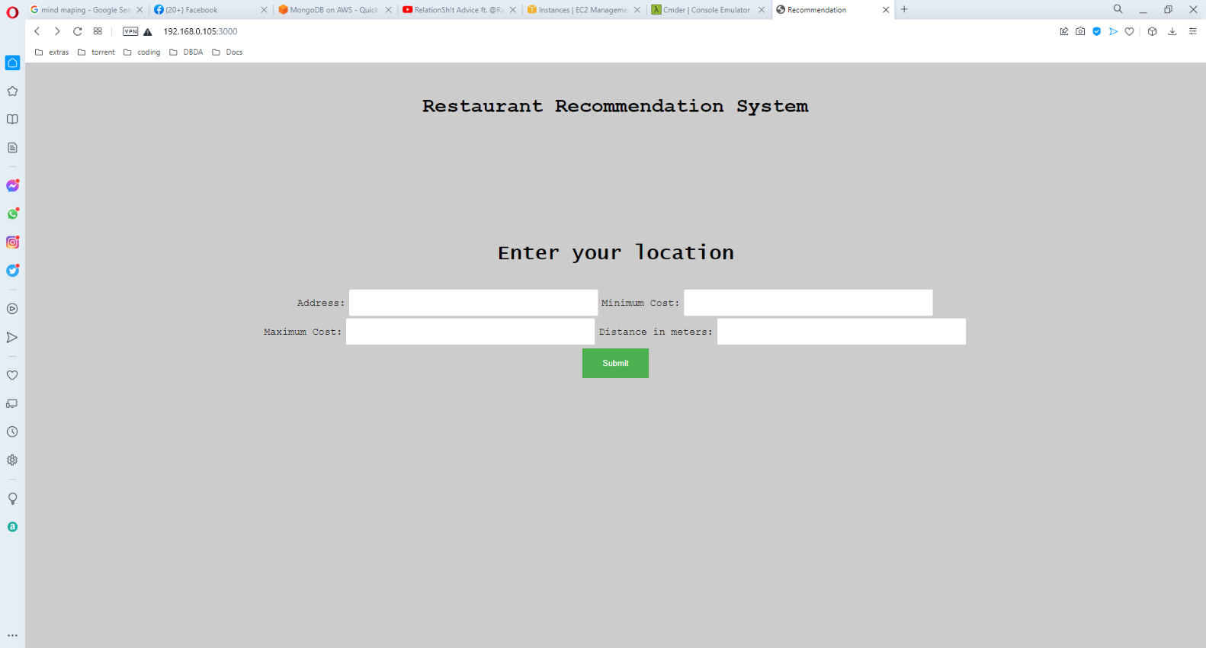
User Interface

Slide 21
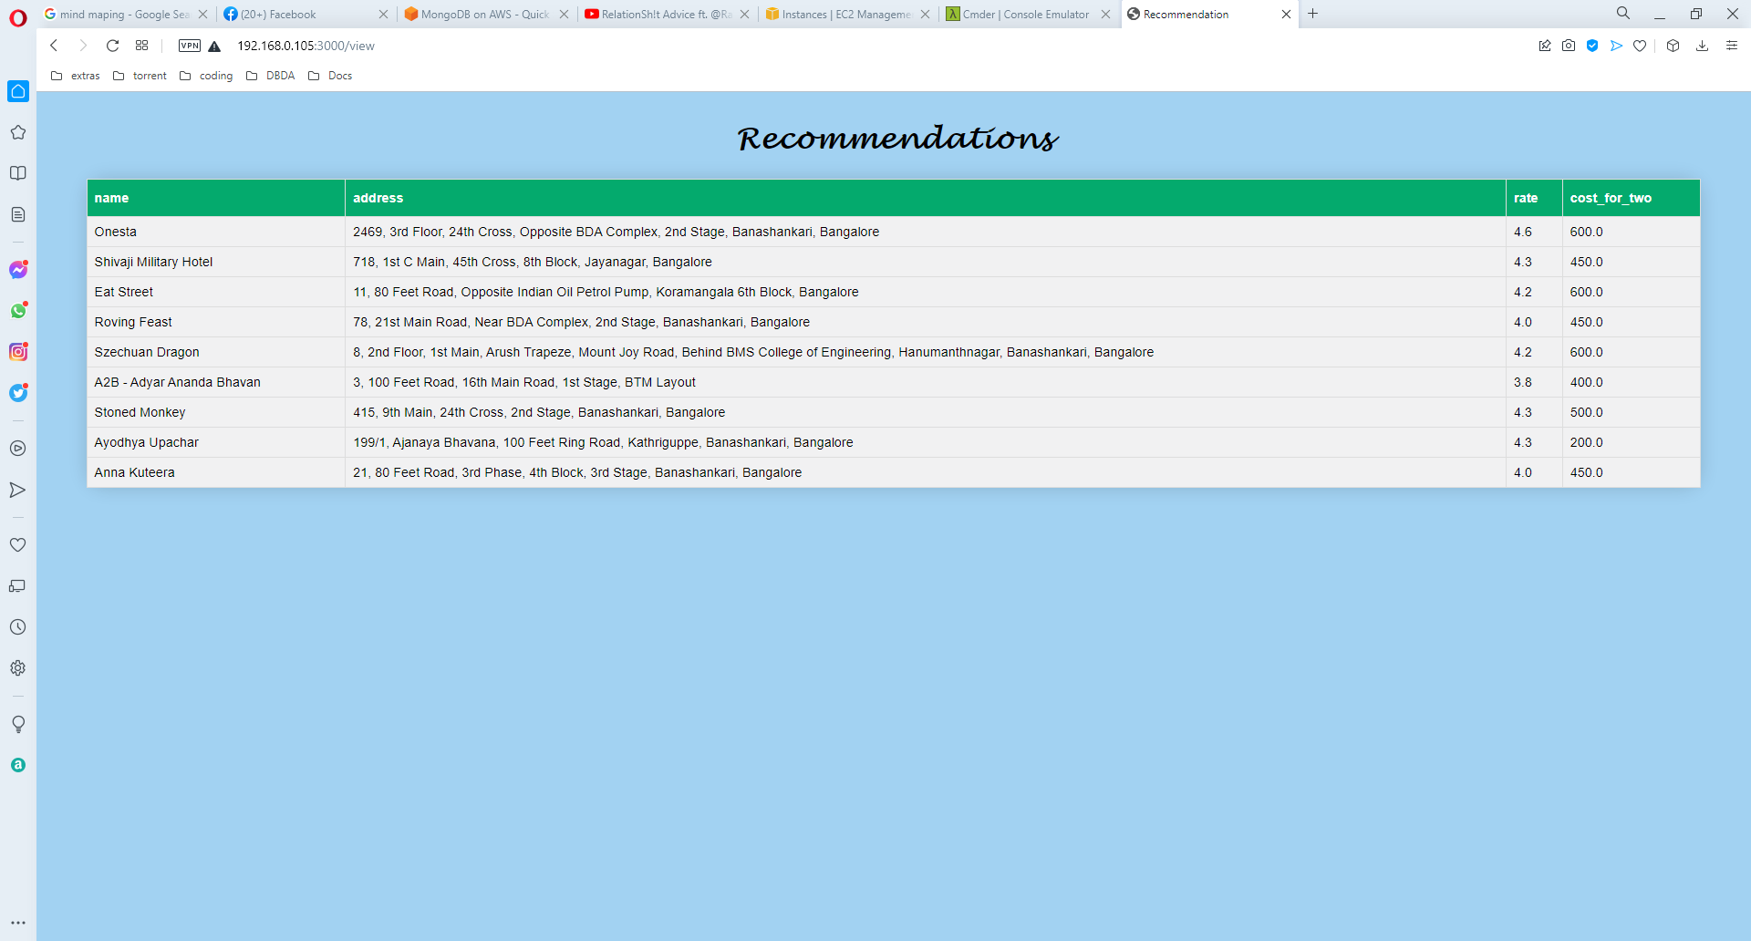
User Interface

Slide 22
Thank You

